Slide 1


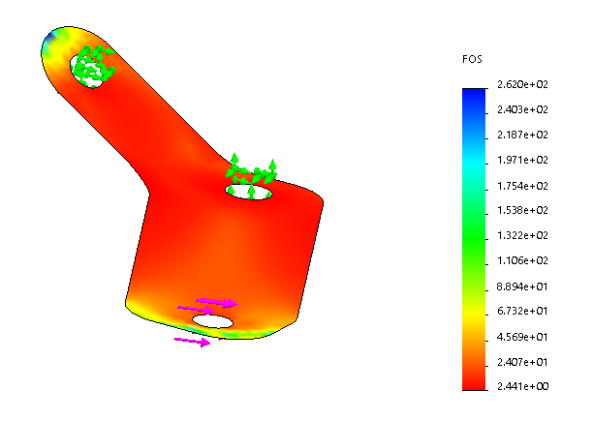
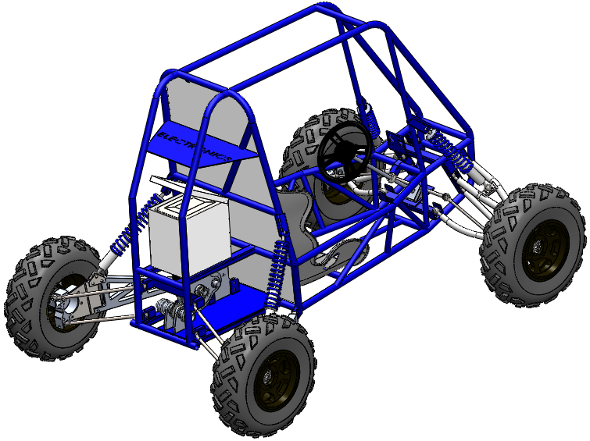
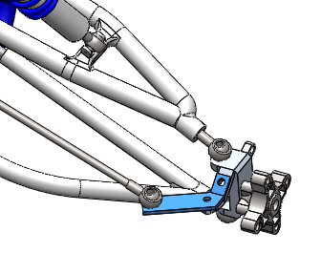
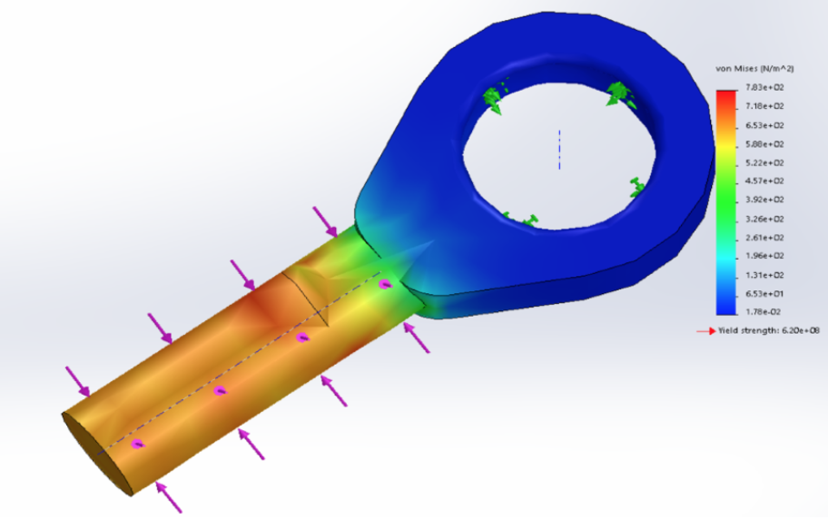
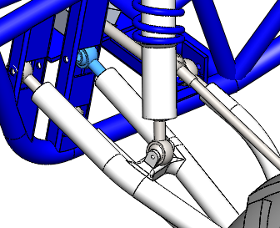
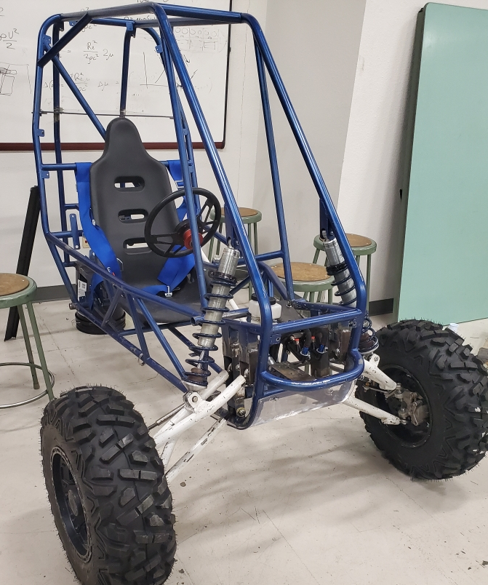
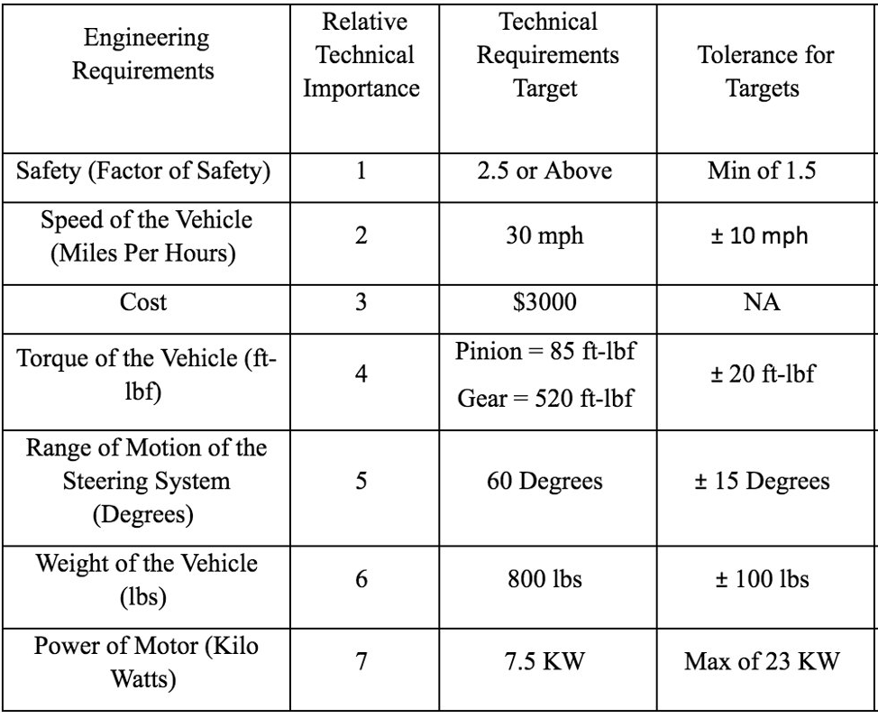
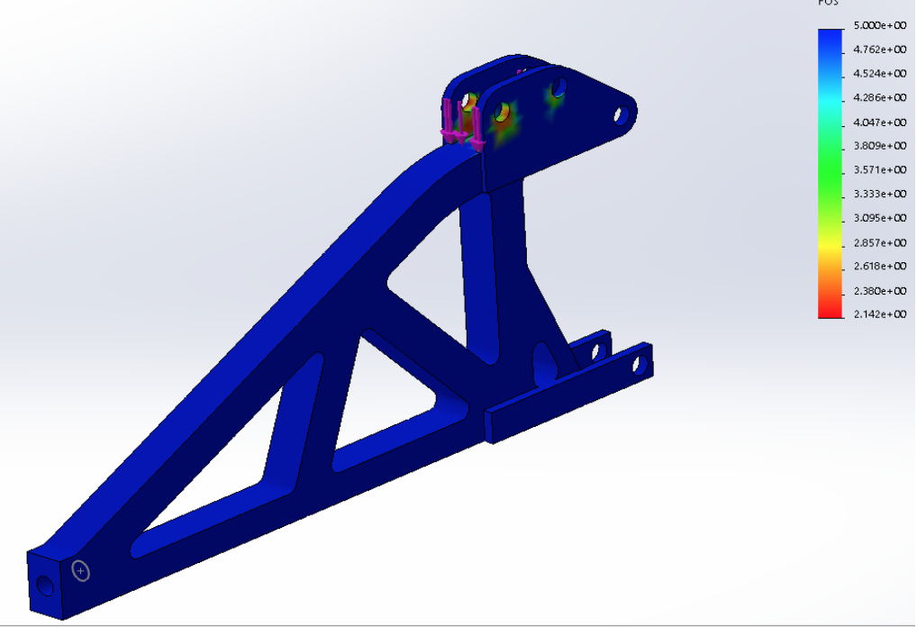
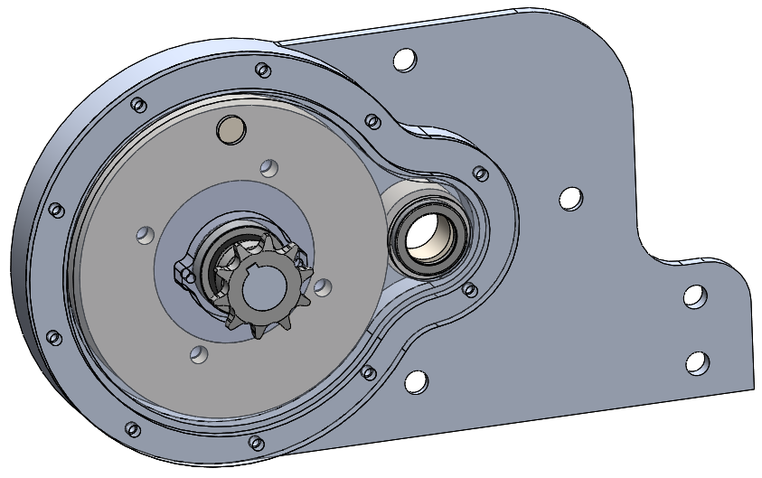
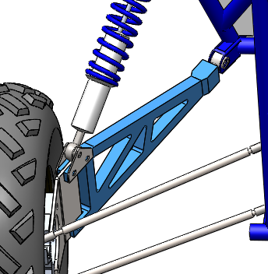
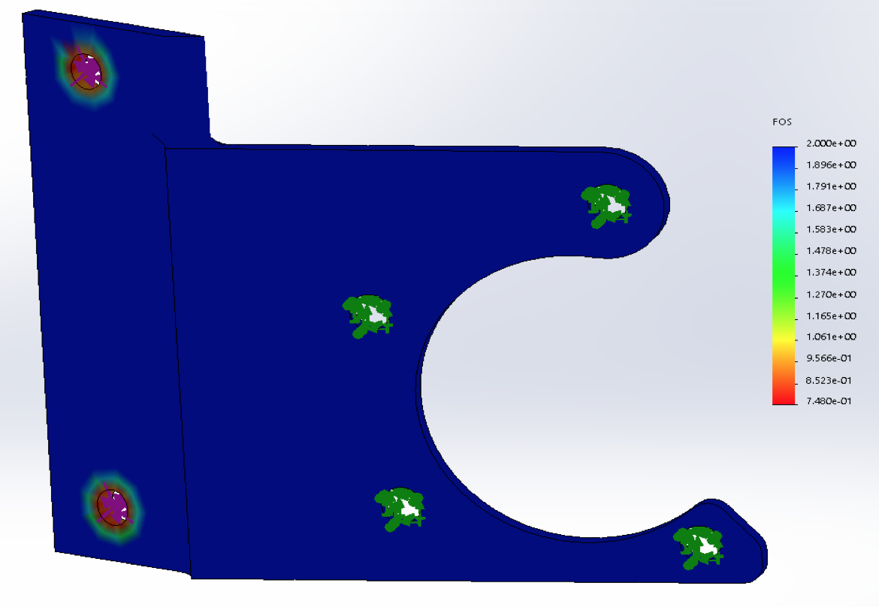
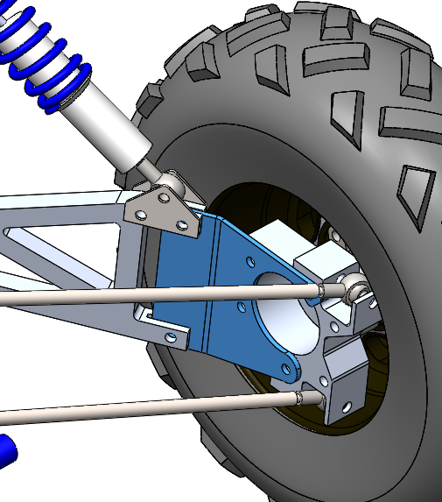
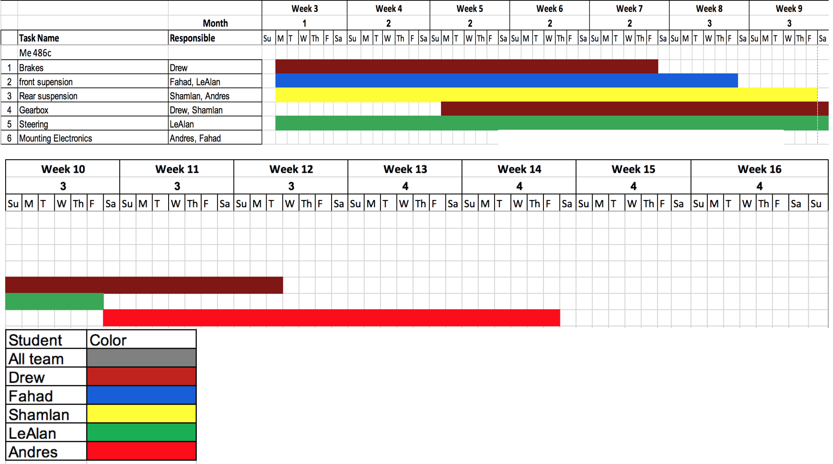
First NAU Electric Vehicle
Shamlan Albahar, Fahad Alhowaidi, LeAlan Kinlecheenie, Drew Stringer
Department of Mechanical Engineering, Northern Arizona University, Flagstaff, AZ 86011
Abstract
Results
Final Design
As of the Fall semester of 2019, the NAU Engineering Department has decided to allow a team of Engineering students to use a previous year’s Baja vehicle and convert it into a full electric Baja vehicle. The team is divided into two sub-teams, Mechanical Engineering (ME) students and Electrical Engineering (EE) students. The ME team is focused on bringing the vehicle up to safety standards, repairing parts such as adding functional brakes, steering, front suspension, designing the rear suspension and a new gear box to set up with an electric motor, along with fabrication to mount the electrical components. The EE team is focused on all electrical components such as the batteries, charging, motor, power electronics and controls. The two teams will combine their resources and knowledge to design a full electric Baja vehicle. This is a first-year project and a first step to designing electric vehicles at NAU. The project is advised under the project’s clients, David Willy (ME team) and Dr. Venkata Yaramasu (EE team). The project is financially sponsored by W. L. Gore and more to come in the project’s year.
Figure 1. Front steering link
Requirements
Figure 10. Back ISO View
Table 1. Engineering Requirements
Figure 4. Front suspension heim joint
Figure 3. Rear suspension trailing arm
Figure 11. Gearbox Model
Figure 12. Front Actual Build
Future Work
References
Figure 2. Rear steering link
[1] U. R. -. B. SAE, "UCSB Racing - Baja SAE," 31 October 2015. [Online]. Available: http://ucsbracing.blogspot.com/. [Accessed 14 October 2019].
[2] G. Ippolito, "Camaro Performance Suspension," Camaro Tech: Performance Suspension, [Online]. Available: http://www.camarotech.com/suspension.html. [Accessed 14 October 2019].
[3] "Camber, Castor & Toe," July 2012. [Online]. Available: http://www.gomog.com/allmorgan/CAMBER_CASTOR_TOE.html. [Accessed 14 October 2019].
[4] T. Schlereth and S. Sparks, "2010 Baja SAE Suspension," Auburn University, 2010.
[5] A. Thosar, "Design, Analysis and Fabrication of Rear Suspension System for an All Terrain Vehicle," International Journal of Scientific & Engineering Research, vol. 5, no. 11, pp. 258-263, 2014.
Acknowledgements
David Willy (Client) Discount Tire (Tire Donation)
Sarah Oman (Capstone Advisor) Ace Hardware (Nut and Bolt Donation)
Constantin Ciocanel (ME Department Chair) Coconino High School (Material Donation)
Perry Wood (Shop Manager) MarZee Waterjet Services (Trailing Arm Manufacturing)
Tanner Gill (Shop Advisor)

